Slide 1
18CSC304J COMPILER DESIGN
UNIT 4
SESSIONS 1, 2 & 3 (a)

Slide 2
Topics that will be covered
Intermediate Code Generation
Intermediate Languages
Three Address Code
Syntax Trees
Postfix
Implementation of Three Address Statements
Quadruples
Triples
Indirect Triples
Syntax Directed Translation & Definition
Syntax tree – Evaluation of Expression – Three address code
Synthesized Attributes, Inherited Attributes

Slide 3
INTERMEDIATE CODE GENERATION

Slide 4
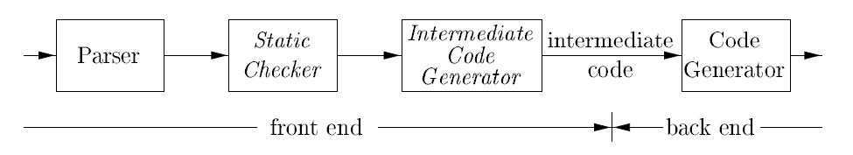
Intermediate Code Generation
In the analysis-synthesis model of a compiler,
The front end translates a source program into an intermediate representation
The back end generates target code from the intermediate representation
Details of the target language are confined to the back end as far as possible
Benefits of using a machine-independent intermediate form
Retargeting is facilitated : A compiler for a different machine can be created by attaching a back end for the new machine to an existing front end
A machine-independent code optimizer can be applied to the intermediate representation

Slide 5
INTERMEDIATE LANGUAGES

Slide 6
Intermediate Languages
There are three kinds of intermediate representations
Three address code
Syntax trees
Postfix Notation

Slide 7
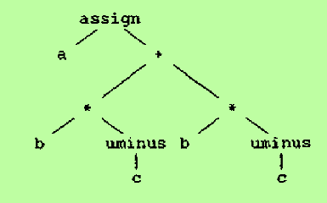
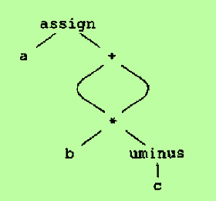
Graphical Representations
SYNTAX TREE
SYNTAX TREE
A syntax tree depicts the natural hierarchical structure of a source program
A syntax tree for the assignment statement a := b * - c + b * - c
DIRECTED ACYCLIC GRAPH (DAG)
A DAG gives the same information but in a more compact way because common subexpressions are identified
DAG

Slide 8
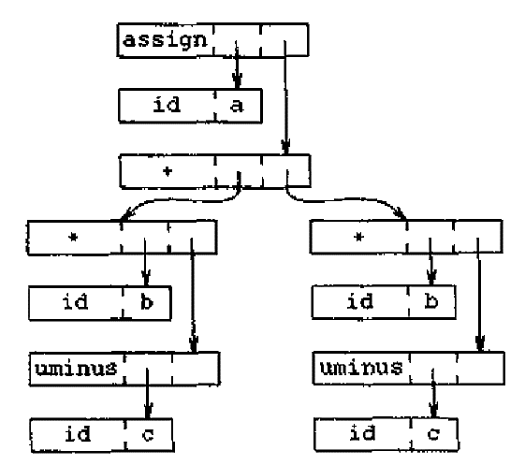
Representations of Syntax Tree
ARRAY REPRESENTATION
Nodes are allocated from an array of records and the index or position of the node serves as the pointer to the node
All the nodes in the syntax tree can be visited by following pointers starting from the root (10)
Syntax tree can be represented in two ways:
Linked List Representation
Array Representation
LINKED LIST REPRESENTATION
Each node is represented as a record with a field for its operator and additional fields for pointers to its children
0 | id | b
1 | id | c
2 | uminus | 1
3 | * | 0 | 2
4 | id | b
5 | id | c
6 | uminus | 5
7 | * | 4 | 6
8 | + | 3 | 7
9 | id | a
10 | assign | 9 | 8

Slide 9
Linear Representation – Postfix Notation
Postfix notation is a linearized representation of a syntax tree
It is a list of the nodes of the tree in which a node appears immediately after its children
SYNTAX TREE
POSTFIX NOTATION
a b c uminus * b c uminus * + assign

Slide 10
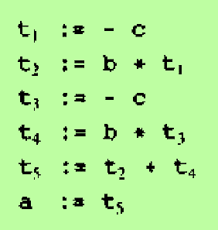
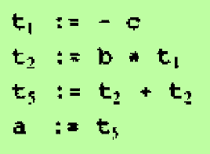
Linear Representation - Three Address Code
Three address code is a sequence of statements of the general form
x := y op z
where
x, y and z are names, constants or compiler generated temporaries
op stands for an operator
Three address code is a linearized representation of a syntax tree or a DAG
The reason for the term “three-address code is that each statement usually contains three addresses, two for operands and one for the result
Code for the syntax tree
Code for the DAG

Slide 11
Types of Three Address Statements
Assignment statements of the form x := y op z where op is a binary arithmetic or logical operation
Assignment instructions of the form x := op y where op is a unary operation
Some of the unary operations are
* unary minus
* logical negation
* shift operators
* conversion operators (eg. Convert a fixed-point number to a floating-point number
Copy statements of the form x := y where the value of y is assigned to x
The unconditional jump goto L (The three address statement with label L is the next to be executed)
Conditional jumps such as if x relop y goto L

Slide 12
Types of Three Address Statements – cont..
param x and call p,n for procedure calls and return y
param x1
param x2
…
param xn
call p,n
These sequence of statements are generated for p ( x1, x2, …., xn )
Indexed assignments of the form
Address and pointer assignments of the form
x := &y
x := *y
*x := y

Slide 13
IMPLEMENTATION OF THREE ADDRESS STATEMENTS

Slide 14
Implementation of Three Address Statements
A three address statement is an abstract form of intermediate code
In a compiler, these statements can be implemented as records with fields for the operator and the operands
Three such representations are
Quadruples
Triples
Indirect Triples

Slide 15
Quadruples
A quadruple is a record structure with four fields
op
arg1
arg2
result
Example: Consider the statement x := y op z
op = op
arg1 = y
arg2 = z
result = x
NOTE
Statements with unary operators do not use arg2
Operators like param do not use arg2 and result
Conditional and unconditional jumps put the target label in result

Slide 16
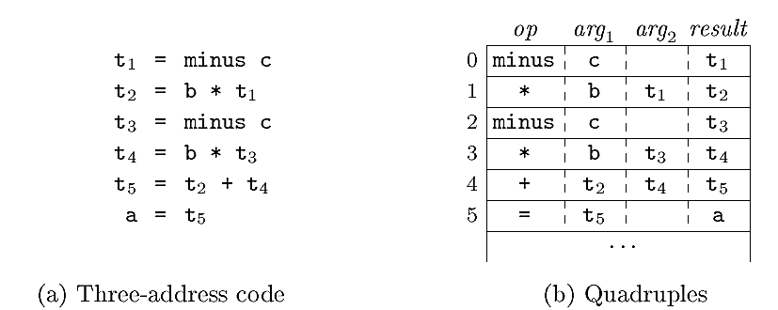
Quadruples – cont..
EXAMPLE
a := b * -c + b * -c
NOTE
The contents of fields arg1, arg2 and result are pointers to the symbol-table entries
So temporary names must also be entered into the symbol table as they are created

Slide 17
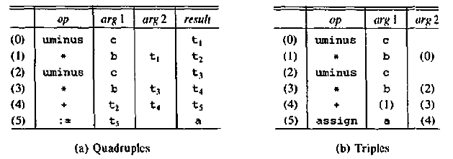
Triples
To avoid entering temporary names into the symbol table, we might refer to a temporary value by the position of the statement that computes it
Thus, we can represent three-address statements with only 3 fields
op
arg1
arg2
Since three fields are used, this format is known as triples
Parenthesized numbers represent pointers into the triple structure itself

Slide 18
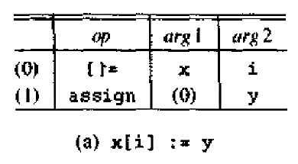
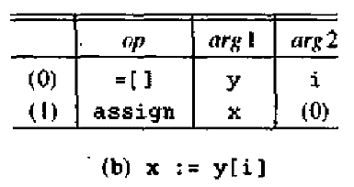
Triples – cont..
A ternary operation like x[i] := y requires two entries in the triple structure
x := y[i] is naturally represented as two operations

Slide 19
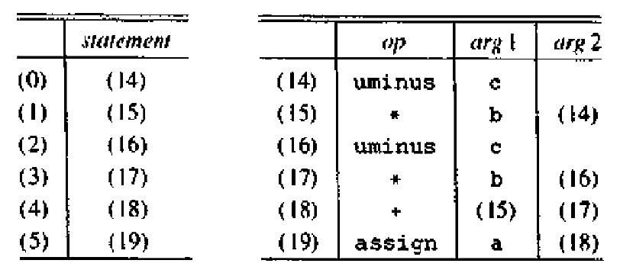
Indirect Triples
Indirect triples list pointers to triples, rather than listing the triples themselves
Indirect Triples
Triples

Slide 20
Comparison of Representations
QUADRUPLES
The benefit of quadruple appears in an optimizing compiler, where statements are often moved around
If we move a statement computing x, the statements using x require no change
TRIPLES
Moving a statement that defines a temporary value requires us to change all references to that statement in arg1 and arg2
This problem makes triples difficult to use in an optimizing compiler
INDIRECT TRIPLES
A statement can be moved by reordering the statement list
Since pointers to temporary values refer to op-arg1-arg2 arrays, which are not changed, none of those pointers need to be changed
So indirect triples is easy to use in an optimizing compiler
QUADRUPLES & INDIRECT TRIPLES
The two notations require about the same amount of space
They are equally efficient for reordering of code

Slide 21
SYNTAX DIRECTED TRANSLATION & DEFINITION

Slide 22
Syntax Directed Translation & Definition
There are two notations for associating semantic rules with productions:
Syntax Directed Definition
Syntax Directed Translation
Both notations are used for specifying semantic checking and for generating intermediate code
Syntax Directed Definition
Syntax directed definitions are high level specifications for translations
They hide many implementation details and they do not specify explicitly the order in which semantic rules are to be evaluated
Syntax Directed Translation
Syntax directed translation schemes indicate the order in which semantic rules are to be evaluated
So they show some implementation details

Slide 23
Syntax Directed Definitions
A syntax directed definition is a generalization of a context-free grammar in which each grammar symbol has an associate set of attributes
There are two types of attributes:
Synthesized Attributes
Inherited Attributes
The value of synthesized attribute at a node is computed from the values of attributes at the children of that node in the parse tree
The value of an inherited attribute is computed from the values of attributes at the siblings and parent of that node
A parse tree showing the values of attributes at each node is called an annotated parse tree
The process of computing the attribute values at the nodes is called annotating or decorating the parse tree
Terminals have synthesized attributes only. Values for attributes of terminals are usually supplied by the lexical analyzer
The start symbol does not have any inherited attributes, unless otherwise stated
A syntax-directed definition that uses synthesized attributes exclusively is said to be an S-attributed definition

Slide 24
Syntax Directed Translation (SDT)
Syntax Directed Translation are augmented rules to the grammar that facilitate semantic analysis
SDT involves passing information bottom-up and/or top-down the parse tree in the form of attributes attached to the nodes
Syntax directed translation rules use
Lexical values of nodes
Constants
Attributes associated to the non-terminals in their definitions
The general approach to SDT is to construct a parse tree or syntax tree and compute the values of attributes at the nodes of the tree by visiting them in some order

Slide 25
Synthesized and Inherited Attributes
Synthesized Attributes
A synthesized attribute is an attribute of the non-terminal on the left-hand side of a production
Synthesized attributes represent information that is being passed up the parse tree
The attribute can take value only from its children (Variables in the RHS of the production)
For eg. Let’s say A->BC is a production of a grammar. A’s attribute is dependent on B’s attributes or C’s attributes
Inherited Attributes
An attribute of a non-terminal on the right-hand side of a production is called an inherited attribute
The attribute can take value either from its parent or from its siblings (variables in the LHS or RHS of the production)
For eg. Let’s say A->BC is a production of a grammar. B’s attribute is dependent on A’s attributes or C’s attributes

Slide 26
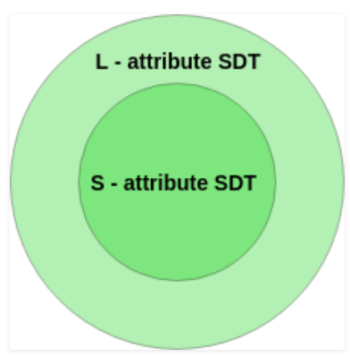
S-attributed and L-attributed SDTs
S-attributed SDT
If an SDT uses only synthesized attributes, it is called as S-attributed SDT
S-attributed SDTs are evaluated in bottom-up parsing, as the values of the parent nodes depend upon the values of the child nodes
L-attributed SDT
If an SDT uses both synthesized attributes and inherited attributes with a restriction that inherited attribute can inherit values from left siblings only, it is called as L-attributed SDT
Attributes in L-attributed SDTs are evaluated by depth-first and left-to-right paring manner
Note
If a definition is S-attributed, then it is also L-attributed but not vice-versa

Slide 27
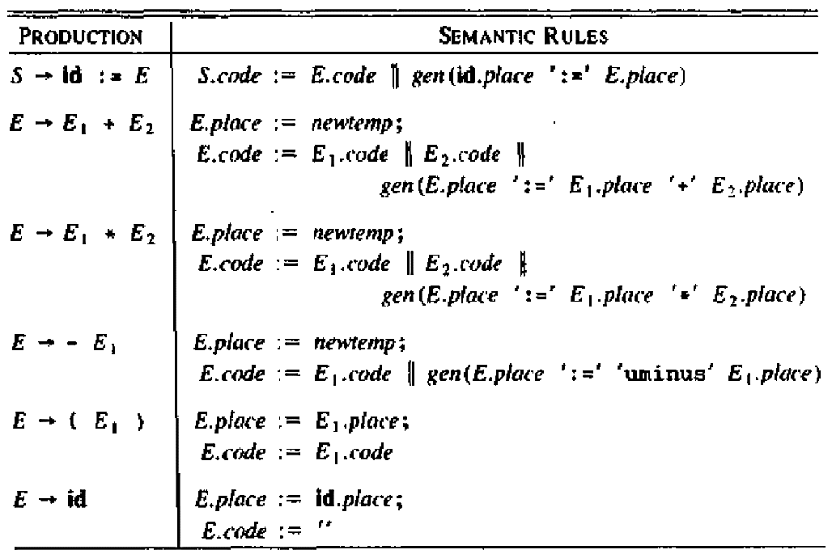
Syntax-Directed Translation into Three-address-code - For Assignment statements
The S-attributed definition given below generates three-address code for assignment statements

Slide 28
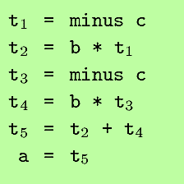
Syntax-Directed Translation into Three-address-code - For Assignment statements – cont…
S.code represents the three address code for the assignment S
The nonterminal E has two attributes:
E.place – the name that will hold the value of E
E.code – the sequence of three address statements evaluating E
The function newtemp returns a sequence of distinct names t1, t2,…
gen ( x ‘:=‘ y ‘+’ z ) represents the three address statement x := y + z
Given the input a := b * -c + b * -c, the definition produces the code

Slide 29
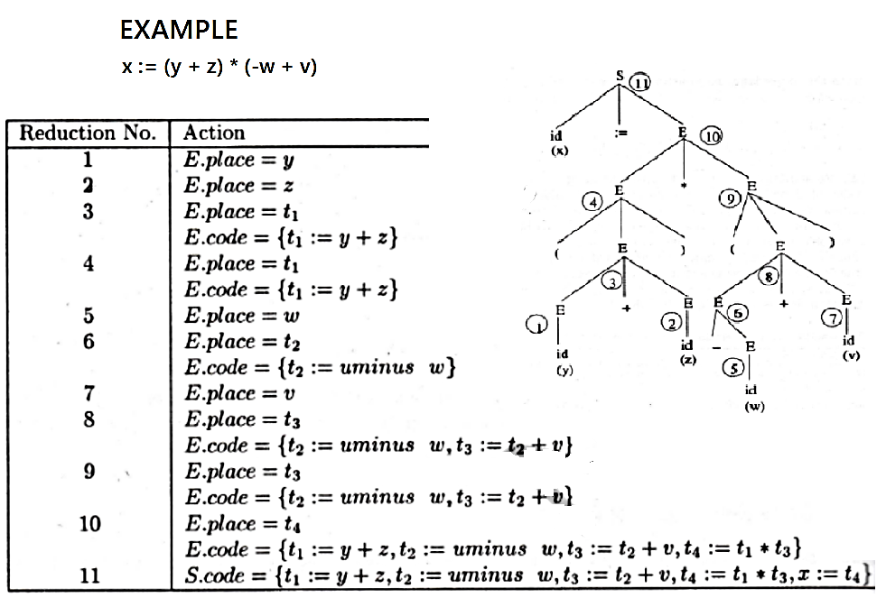
Derivation of the string from the grammar:
S => id := E
=> id := E * E
=> id := E * ( E )
=> id := E * ( E + E )
=> id := E * ( E + id )
=> id := E * ( -E + id )
=> id := E * ( -id + id )
=> id := ( E ) * ( -id + id )
=> id := ( E + E ) * ( -id + id )
=> id := ( E + id ) * ( -id + id )
=> id := ( id + id ) * ( -id + id )

